Slide 1
EOX Application
Overview
Design
Implementation

Slide 2
Overview

Slide 3
Business Operating System
Digital Platform for participants to connect and conduct business through end-to-end workflows, communication and exchange of data
Participant
Participant
Participant
System of Records
System of Records
System of Records
Workflows / Communication / Data Exchange

Slide 4
Digital Organization
Digitally manage operations and governance
Operations
Data Entry
Governance
Real time Visibility
Workflow Activities
Collaboration
Outcome Vs Goal
Corrective Actions

Slide 5
Organization Digital Maturity Model
Level 1
Operations
Operational Reports
Level 2
Level 3
Corrective Actions
RYG based tracking
Dimension wise Facts Performance
Timelines, QoS

Slide 6
EOX App Features
Multi Tenant App
Support Custom
Workflows
Forms
Documents
Business logic
Application Interface
Dashboards
Widgets with support for rich visualizations
Define Performance Indicators against
Dimensions (Time, user) / Business Facts (Sales, Revenue)
Timelines, QoS
RYG tracking using Performance Indicators
Rules to trigger corrective actions

Slide 7
EOX App Features (contd)
Chat/Email for Collaboration
Chat/Email notifications with predefined templates
Dashboards with support for Aggregates, charts and tables
Application Development Kit (ADK)
Application Runtime Environment (ARE)

Slide 8
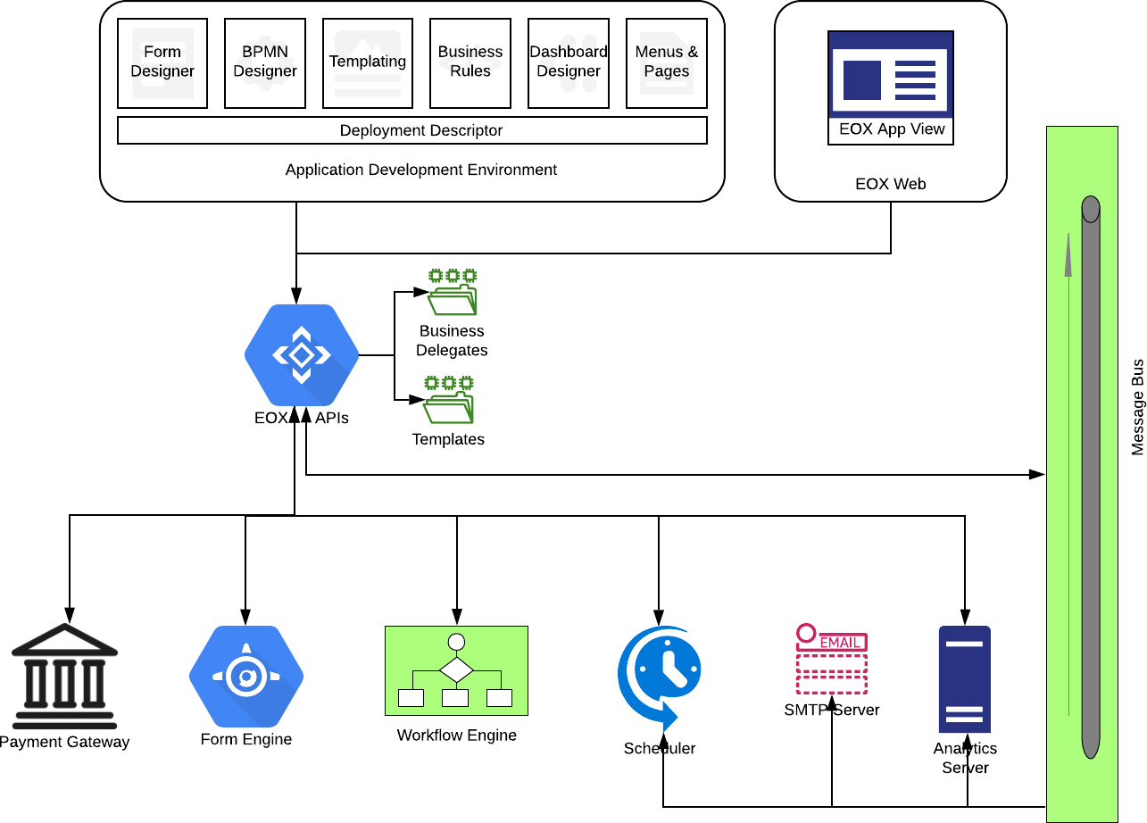
Application Architecture

Slide 9
How is it built?
Independent codebase management
Declarative/Visual approach to build App
Visual BPMN Workflow builder
Visual Form and Page builder
Templating for email and pdf documents
Application interface design – Menus
Business Delegates - Develop and Test
Dashboard Designer
Access control for menus/pages
Automated application deployment

Slide 10
EOX App Structure
Pages
File Views
Assignments / Inbox
Claim
Perform Activity
Columns
Filters
Sort
Status wise Actions
Activity Log
Comments
View
Modify
Initiate Workflow
Fields
Document Viewer
Search
Custom Pages
Custom Pages
List
HTML Document
Document Viewer
Forms
Dashboard
Menu
Site
Participant
Dashboard
Widgets

Slide 11
Application Folder Structure
content
workflows
pages
forms
entity
data
delegate
template
migrations
view
gui
themes
apps
application.yml
test

Slide 12
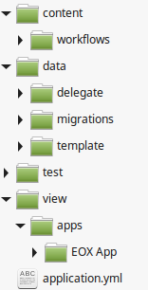
Application Folder Structure
content
workflows
pages
forms
entity
data
delegate
template
migrations
view
gui
themes
apps
application.yml
test
Business Delegates
Custom rules implemented using PHP.
Access restricted to application's database

Slide 13
Application Folder Structure
content
workflows
pages
forms
entity
data
delegate
template
migrations
view
gui
themes
apps
application.yml
test
Migrations
Sandboxed Application database with multi tenant support.
Version migrations using SQL scripts

Slide 14
Application Folder Structure
content
workflows
pages
forms
entity
data
delegate
template
migrations
view
gui
themes
apps
application.yml
test
Tests
Automated PHPunit integration tests to verify the delegate tests

Slide 15
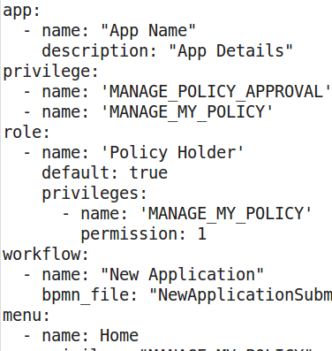
Application Folder Structure
content
workflows
pages
forms
entity
data
delegate
template
migrations
view
gui
themes
apps
application.yml
test
Deployment Descriptor

Slide 16
Web client
Data driven rendering of menu and pages
Multi-level menus
Access control
Pages with various content elements
Forms
Tables
Static HTML content
Dashboards
Document Viewer

Slide 17
Design

Slide 18
The Account Model
Account
Users
Offering
Business Role
User Roles
User Profile
Entity
Business Profile
Employee Profile
Child Organizations

Slide 19
Inter-organization Collaboration
Org 1
Initiate Workflow
Org 2
Task Assigned to public contacts for the role
Internal tasks can be assigned to specific users/roles within organization
Select Business Participant Organization to assign the next activity to
Chat communication with contact users in other organization
Chat messages are visible to contact people who can respond back
Org 2
Chat communication can happen with other users within the organization
Tasks can be assigned to other users within the organization

Slide 20
Chat Collaboration
Originating Participant
Chat / Comment on File
Chat Bot
Intercept
Recipient Participant
Receive on Chat
Establish Context
File
Route
Update File Comments
New / reply to existing thread

Slide 21
The Entity Model
Entity
Workflow
Activity
Fields
Form
Fields
Form
Status Field
Name
Data type
Start Date Field
End Date Field
KPIs
Timelines
QoS
Indexed (Y/N)
Participant
Identifier
Account Type
Business Role

Slide 22
The File Model
File
Business Participants
KPIs
Start date
End Date
Version
Workflow
Status
Timelines
QoS
Business Role
Organization
Parent File
RYG Status

Slide 23
Business Delegate Model
AppDelegate
AbstractAppDelegate
DocumentAppDelegate
AbstractDocumentAppDelegate
CommunicationDelegate
MailDelegate
TemplateAppDelegate
FileDelegate
Traits
FileTrait
UserContextTrait
SmsDelegate
WorkflowTrait

Slide 24
App Builder
App Builder
Form Builder
BPMN Builder
Page Builder
Job
Role
Dashboard
Association
Menu Builder
Privileges
Field Reference
Form Designer
List
Activity Log
Form
HTML Content
Entity
Field Validation
Export / Import
Deploy App
Form Components
Forms
Resources
Page Section

Slide 25
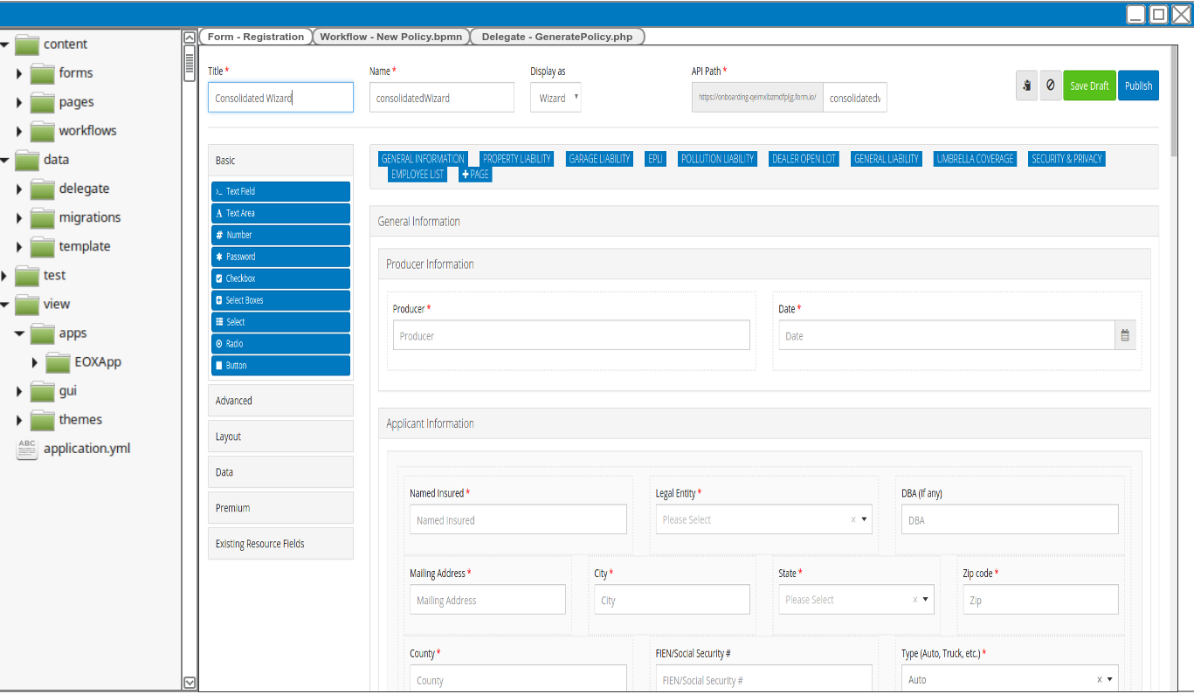
App Builder (FormIO Builder)

Slide 26
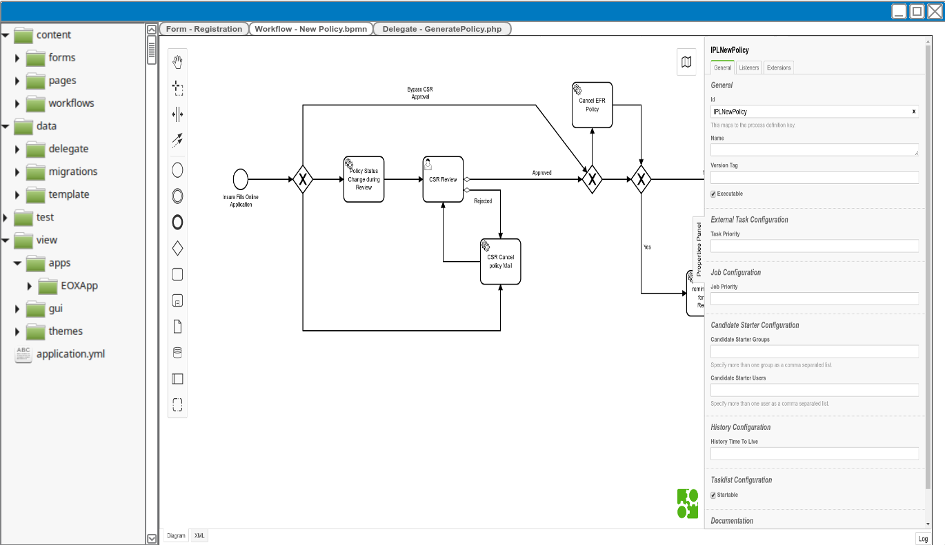
App Builder (BPMN Builder)

Slide 27
Key API’s
App – create, export, import, deploy, install, getMenu, getPage, getForm, saveForm, getWorkflow, saveWorkflow
User - Signup and Signon
Payment - initiate, process, update
Workflow - submission, assignments, search, claim
Pipeline - execute
Document - generate, get
Email - send
Entity - get, save
Jobs - schedule, cancel
Analytics - executeQuery, CRUDs for widget, query

Slide 28
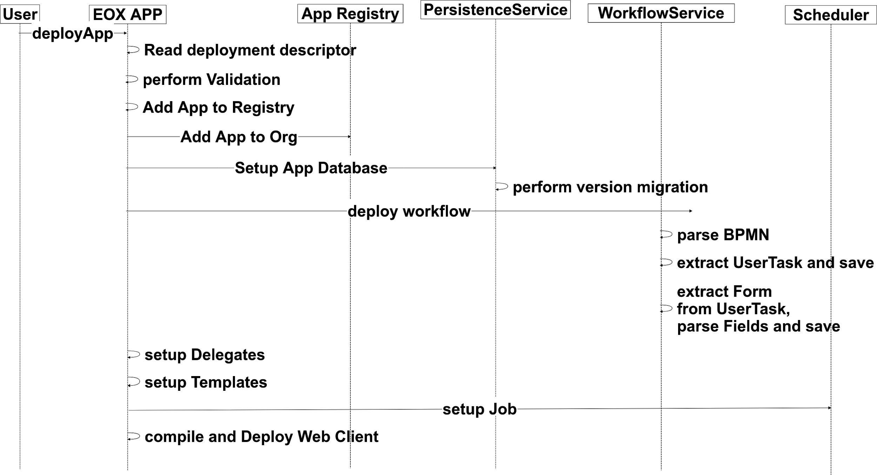
App Deployment

Slide 29
Implementation

Slide 30
Technology Stack
Workflow Engine
Form Engine
Templating
PDF generation
Message Bus
Charting
Scheduler
SMTP Server
Analytics Server
Camunda
FormIO
Smarty
Snappy, WkHtmlToPdf
ActiveMQ
AMCharts
Quartz
Postfix
Elastic

Slide 31
Implementation Flow
Define Entity
Link forms to Workflow Activities
Implement Templates
Develop Delegates
Implement DB Migrations
Setup Menu / Pages
Deploy App in Dev Server
Version & Export App
Import & Deploy in target Environment
Install for Organization
Setup Roles/Privileges
Create App
Define App details
Start App Builder
Load the Application Folder
Design Form
Fields are validated against entity fields
Add Workflows for Entity
Write unit tests
Test Delegates
Test App
Check in to Git
Setup Org specific configurations
UI Testing
From Admin
Template based App setup
Setup Scheduled Jobs
Create New Fields
Add existing entity fields
Fields can be added here
Fields are added during Form design

Slide 32
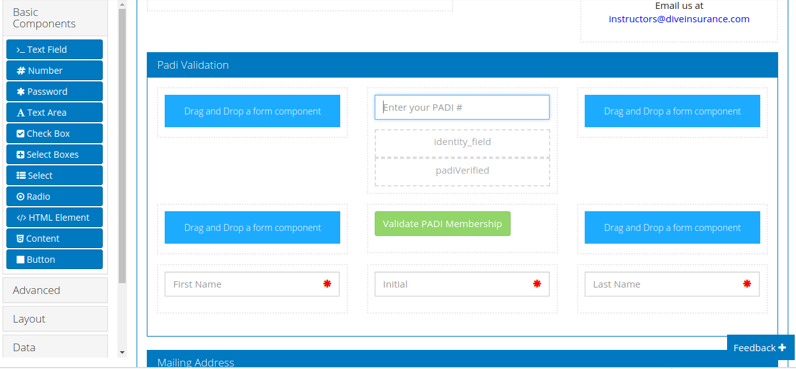
Form Design

Slide 33
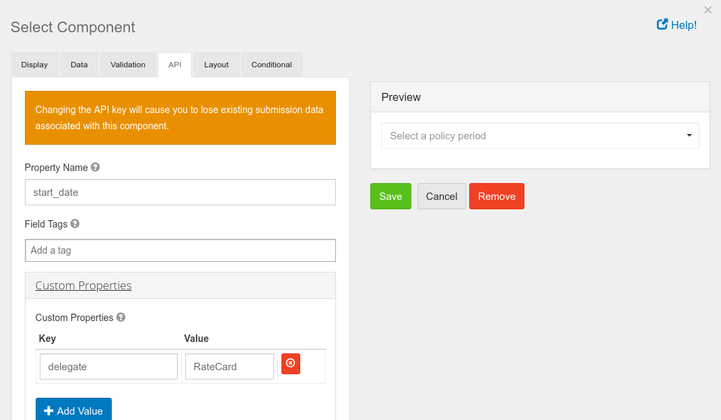
Form Design – Delegate
Delegate name

Slide 34
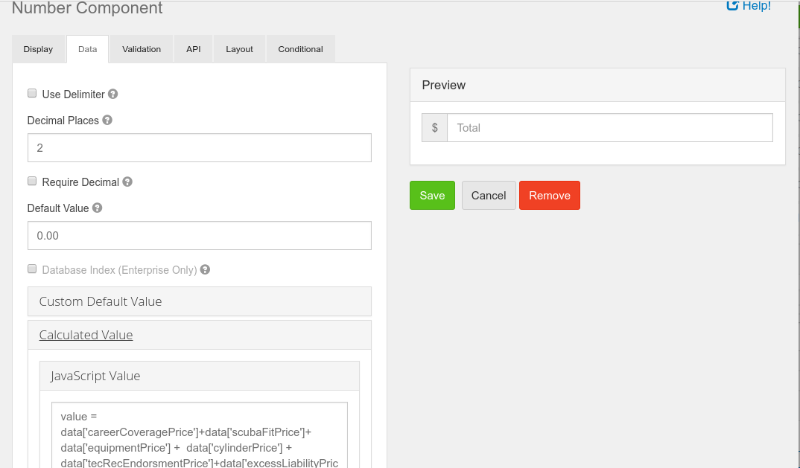
Form Design – Javascript
Javascript Initialization

Slide 35
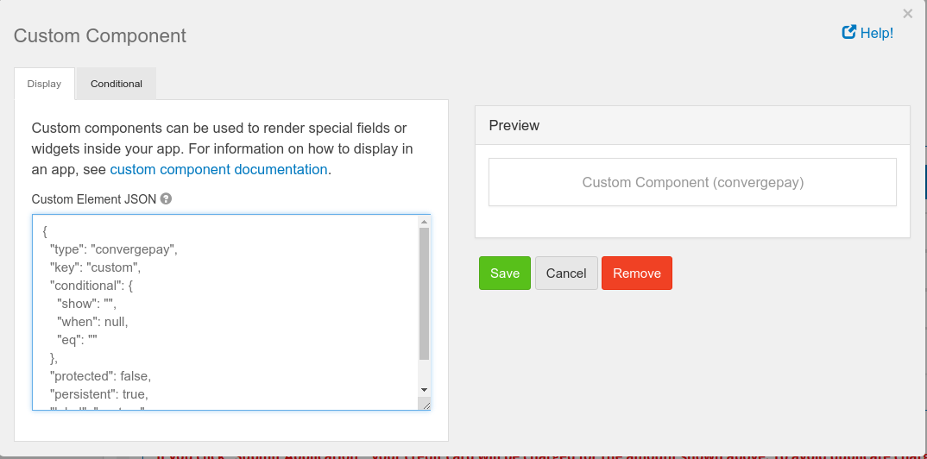
Form Design – Payment

Slide 36
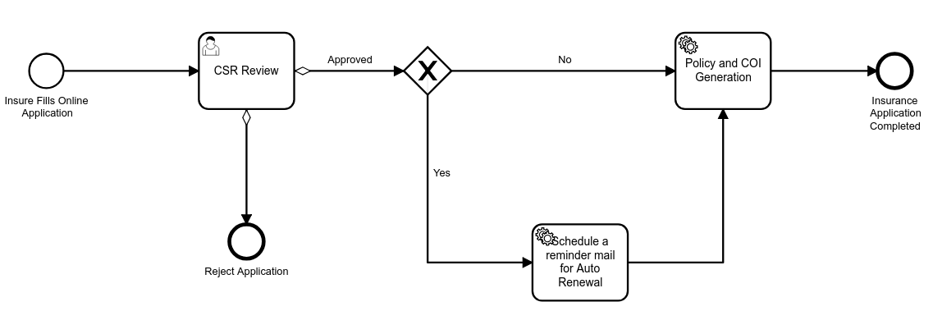
Workflow - New Policy

Slide 37
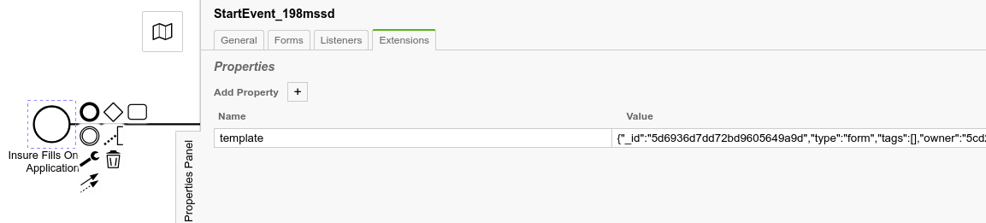
Workflow Design – Form Template
Form Template

Slide 38
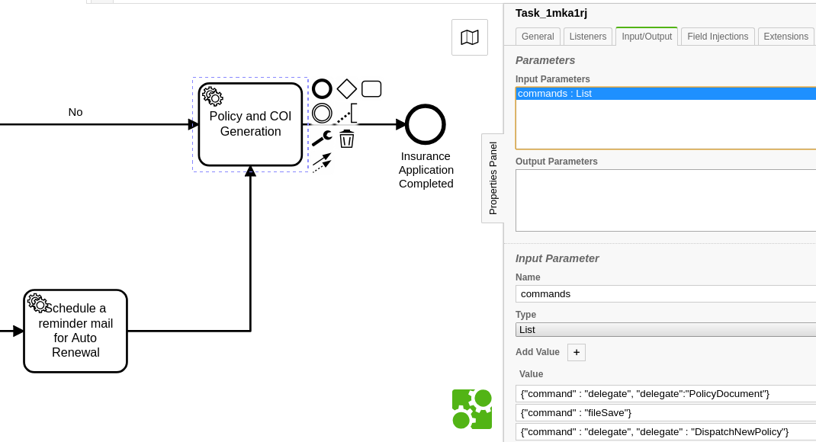
Workflow Design - ServiceTask
Supported Commands
file
filesave
scheduleJob
cancelJob
delegate

Slide 39
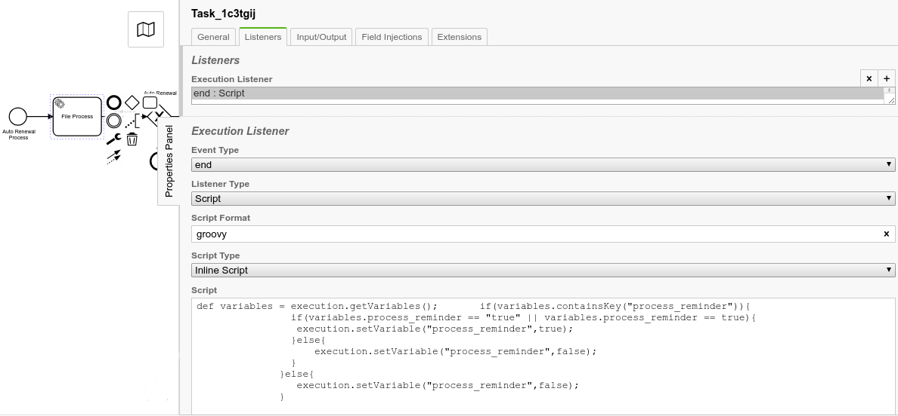
Workflow Design - Script
Javascript / Groovy

Slide 40
Thank You

